Slide 1

Insaaf Insight
A Legal Assistant
Submitted by
Ishaan Bhalla (20CSU364)
Priyanshu Mishra (20CSU360)
Mukul (20CSU355)
Mentored by
Dr. Nitin Malik
Prof. & Dy Dean (RDIL & PhD)

Slide 2



Contents
Introduction
Existing Solutions & Literature Survey
Comparison with Existing Literature
Gap Analysis
Problem Statement
Objectives
Tools / Platforms Used
Solution Methodology
Outcomes
Gantt Chart
Responsibility Chart

Slide 3



INSAAF INSIGHT
A LEGAL ASSISTANT
HOLMES
ABOUT US
APP
Insaaf Insight is project aimed at enhancing the accessibility and efficiency of the Indian legal system through the integration of artificial intelligence (AI). Our moto is to make legal knowledge easily accessible and understandable for everyone, regardless of their legal expertise.

Slide 4

Introduction
Our project began with a broad exploration of how artificial intelligence (AI) can be implemented within the Indian legal system and the potential benefits it can deliver. During our research on existing AI implementations and possible application areas, we concluded that two major avenues would offer the most benefit to the general public. This led to the development of "Insaaf Insight," a project consisting of two components:
1. Chat-Based Legal Assistant
2. AI-Driven Library of Legal Precedents
Our research primarily focuses on the implementation strategies for these components, aiming to leverage AI to enhance accessibility and efficiency in legal processes.

Slide 5
As per our surveys and research, various applications exist in the market that offer users access to legal information and services. Some of the most notable applications are:
MyAdvo
LawRato
IndiaFilings
All these applications provide users with legal services such as consultations, document drafting, and legal advice. They typically operate on a centralized platform where users can request services, and these services are delivered by legal professionals through the application.
Existing Solutions
&
Literature Survey

Slide 6
Comparison With Existing Solutions
Existing Apps | Insaaf AI
An entity or company holds the authority to make major decisions regarding the platform and provides necessary services. | Utilizes advanced AI and a comprehensive legal dataset to autonomously provide legal information, reducing reliance on centralized human decision-making authority.
Information is stored in servers. | Information is stored in a database ensuring efficient retrieval and easy data management.
No integration with Large Language models for legal inquiries. | Uses advanced AI (Llama language model) trained on extensive legal data to provide accurate and contextually relevant legal information.
No comprehensive database of legal precedents. | Offers a searchable database of legal precedents, allowing users to reference past judicial decisions easily.

Slide 7

Impact of Resource-conscious AI Projects
Benefits of Resource-conscious AI Projects
1. Cost-effectiveness:
Resource-conscious AI projects can save money by using open-source AI frameworks and freely available resources.
Streamlining project scope and resource allocation maximises the use of available resources.
Resource-conscious AI initiatives highlight how persistence and creative problem-solving may lead to cutting-edge AI solutions on a low budget.

Slide 8
Problem Statement
In the legal domain, the accessibility and analysis of relevant statutes and case precedents are fundamental to informed decision-making and effective legal reasoning. Traditional methods of legal research are often time-consuming and require extensive manual effort, which can delay legal proceedings and decision-making processes. Despite advancements in technology, the legal profession continues to face significant challenges in efficiently navigating the vast amounts of legal texts and case law.

Slide 9
Objectives
Enhance Legal Research Efficiency: Significantly reduce the time and effort required for legal professionals and the public to access and interpret legal information.
Improve Accessibility of Legal Resources: Make legal texts, especially complex statutes and case precedents, more accessible and understandable to non-experts.
Foster Informed Legal Decision-Making: Provide users with reliable, contextually relevant legal information to support more informed decision-making in legal contexts.
Innovate Legal Information Delivery: Introduce cutting-edge technology into the legal field to modernize how legal information is processed and delivered.

Slide 10

Tools and Platform Used
Programming Languages and Frameworks:
Python: Used for scripting and automating tasks such as text processing, data loading, and embedding.
2. Natural Language Processing (NLP) Libraries:
Hugging Face Transformers: Provides pre-trained models and utilities for
embedding generation and natural language understanding, for Llama-3-8b.
FAISS (Facebook AI Similarity Search): Used for efficient similarity search and retrieval of documents based on embeddings.

Slide 11
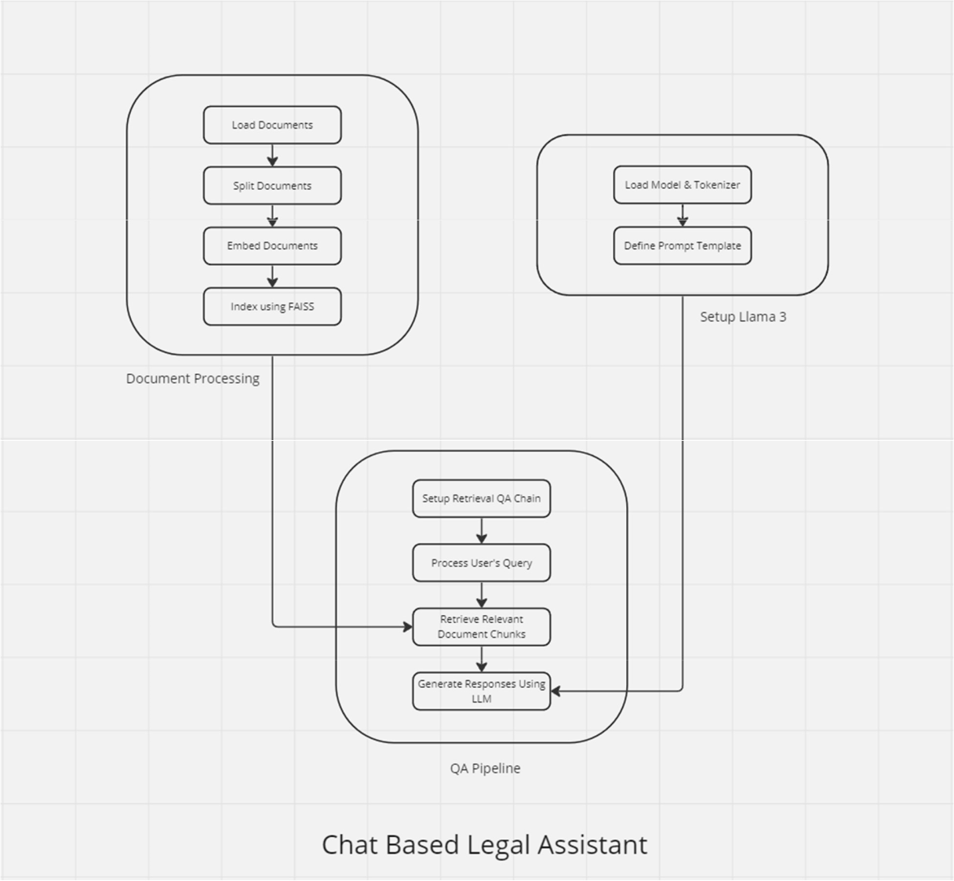
Methodology

Slide 12
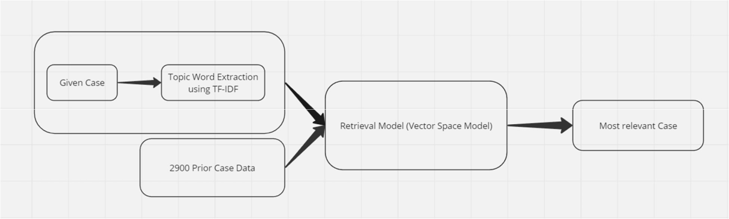

Slide 13
Outcomes
1. Enhanced Legal Research Efficiency
The project significantly reduced the time required to access and interpret legal information. Legal professionals and students can now retrieve statutes and case precedents in a matter of seconds rather than hours, dramatically increasing productivity.
2. Improved Legal Accessibility
The chat-based legal assistant has made legal information more accessible to the general public, including those without a legal background. This tool simplifies complex legal terminology and provides clear, concise explanations, helping individuals understand theirlegal rights and responsibilities more effectively.

Slide 14
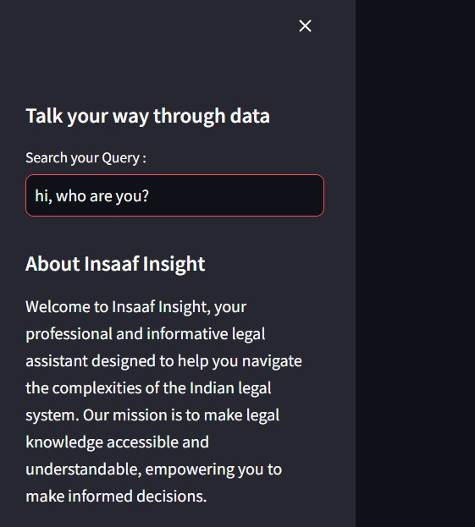
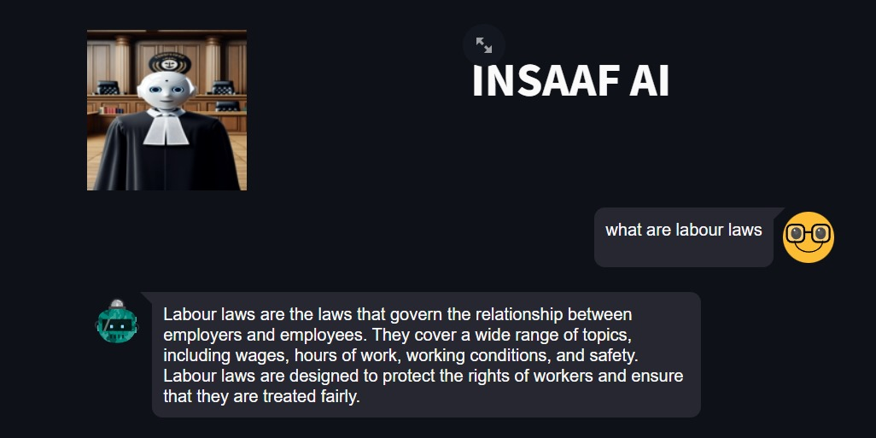
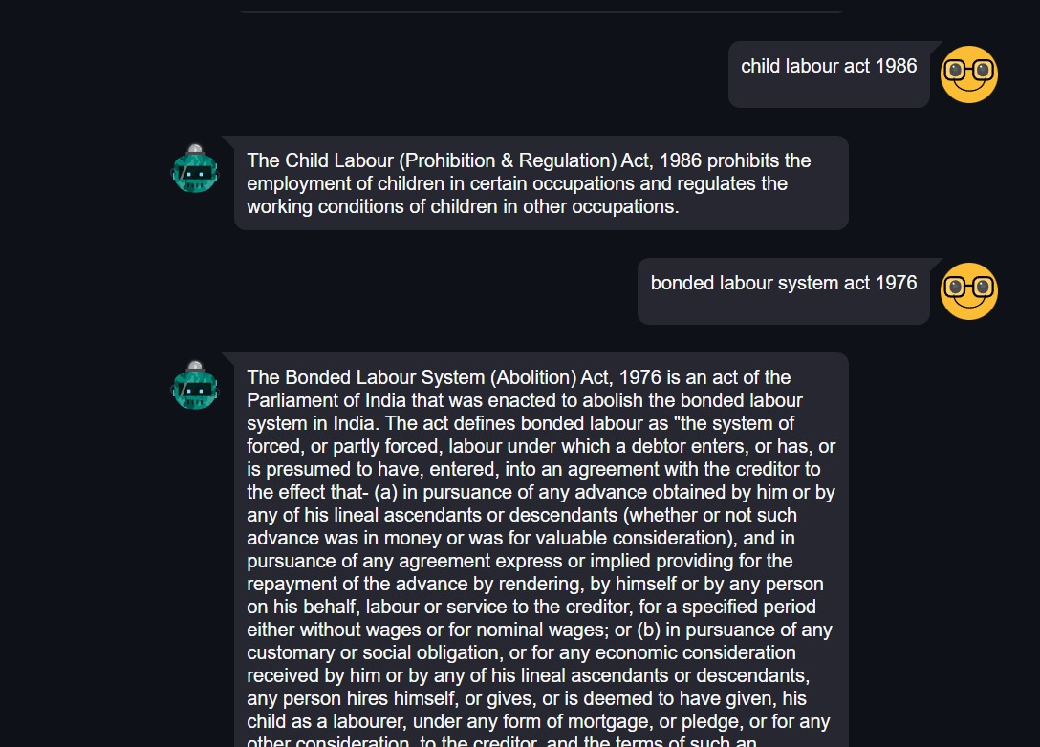

Working
Insaaf-Insight

Slide 15
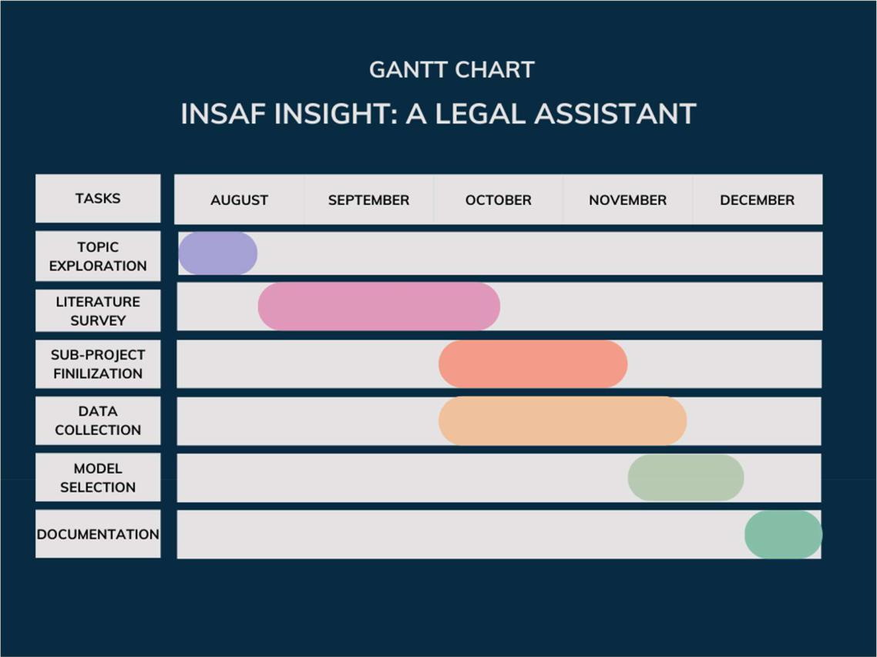
Gantt Chart

Slide 16
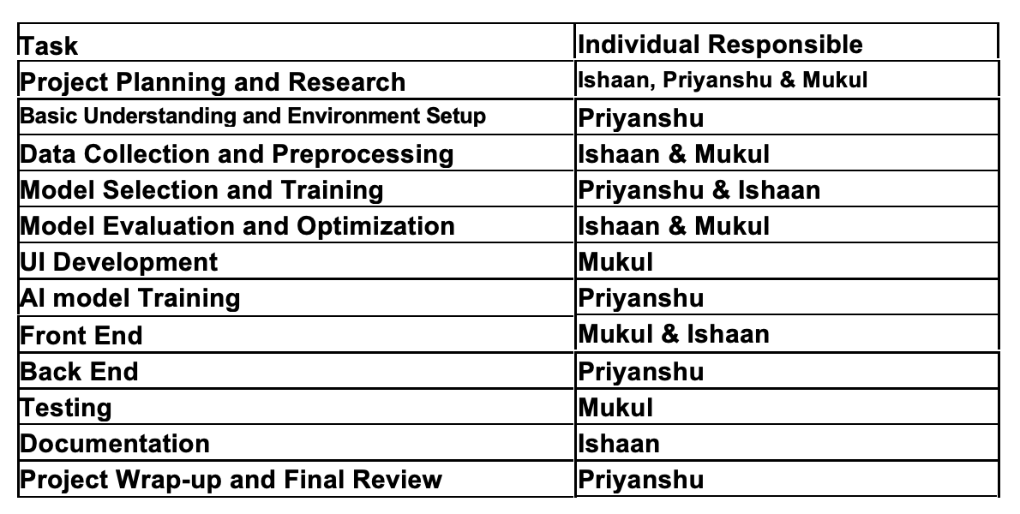
Responsibility Chart

Slide 17


Thank you

